Slide 1
Recursion
Uldis Straujums
2019, 2022

Slide 2


What is «recursion»?
A visual form of recursion known as the Droste effect. The woman in this image holds an object that contains a smaller image of her holding an identical object, which in turn contains a smaller image of herself holding an identical object, and so forth.
1904 Droste cocoa tin, designed by Jan Misset.

Slide 3

What is «recursion»?
In Western art history, Mise en abyme (French pronunciation: [miz ãn abim] is a formal technique of placing a copy of an image within itself, often in a way that suggests an infinitely recurring sequence.
In film theory and literary theory, it refers to the technique of inserting a story within a story.
The term is derived from heraldry and literally means "placed into abyss".
Coat of arms of the United Kingdom 1816–37

Slide 4
What is «recursion»
Recursion (adjective: recursive) occurs when a thing is defined in terms of itself or of its type. (Wikipedia)
Recursion is the process of repeating a function, each time applying it to the result of the previous stage.
Word origin : 1930s: from late Latin recursio(n-), from recurrere ‘run back’, from re- ‘again, back’ + currere ‘run’. (Oxford Learner’s Dictionaries)
Recursion is the determination of a succession of elements (such as numbers or functions) by operation on one or more preceding elements according to a rule or formula involving a finite number of steps. First known use 1790, in the meaning «Return». (Merriam-Webster dictionary)
Recursion is a computer programming technique involving the use of a procedure, subroutine, function, or algorithm that calls itself one or more times until a specified condition is met at which time the rest of each repetition is processed from the last one called to the first.
(Merriam-Webster dictionary)

Slide 5
What is «recursion»
Informally, recursion is an entity that refers to itself.

Slide 6



Recursion in real life - permutations
In how many ways we can arrange n persons in a row?
factorial function n! is defined:
0! = 1
n! = n * (n-1)!
n = 3 There are 3*2 ways
We can arrange n persons in a row in n! (n-factorial) ways.
The earliest publication that discusses this sequence appears to be Sepher Yezirah [Book of Formation], circa AD 300.

Slide 7
Recursion in real life - language
Every language is built using a principle:
make infinite use of finite means
Linguist Noam Chomsky frequently quotes Wilhelm von Humboldt's description of language
as a rule-governed system which "makes infinite use of finite means",
meaning that an
infinite number of sentences can be created
using a finite number of grammatical rules.
text = sentence
text = text sentence
number = digit
number = number digit
digit: one of
0 1 2 3 4 5 6 7 8 9

Slide 8
Computer program to calculate factorial
factorial function n! is defined:
0! = 1
n! = n * (n-1)!
def factorial(n):
'''recursive factorial computation in Python'''
if n == 0: return 1
return n * factorial(n-1)
print (factorial(3)) # 6
print (factorial(21)) # 51090942171709440000
We can run Python programs online at:
https://repl.it/languages/python
We can prepare test cases for our program using Internet site
https://www.wolframalpha.com
From Wolfram site we get 21! = 51090942171709440000

Slide 9
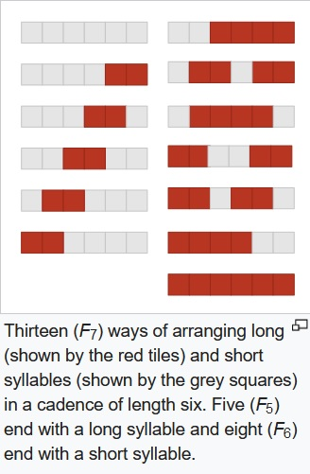
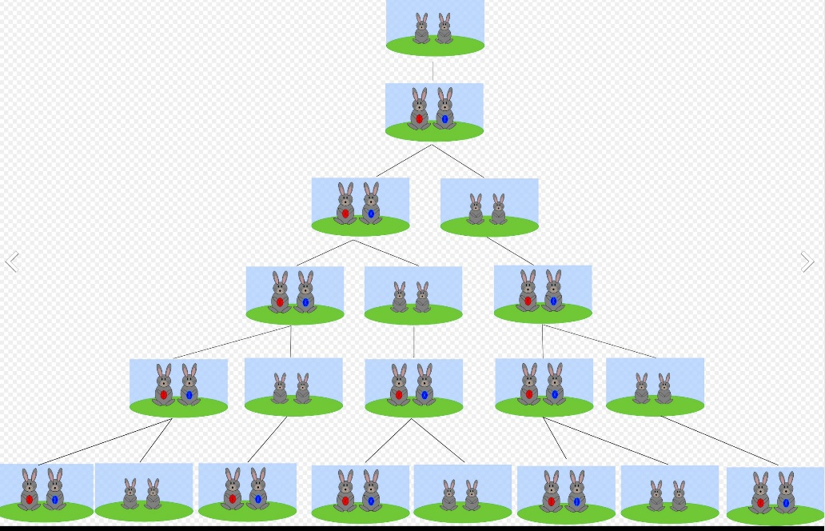
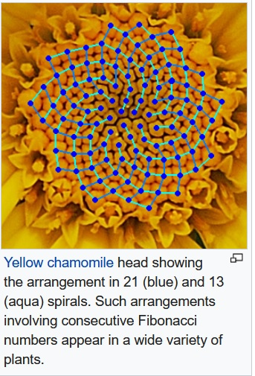
Recursion in real life – Fibonacci numbers
Fibonacci numbers are named after Italian mathematician Leonardo of Pisa, later known as Fibonacci.
They appear to have first arisen as early as 200 BC in work by Pingala
on enumerating possible patterns of poetry formed from syllables of two lengths.
Rabbit pairs form Fibonacci sequence

Slide 10
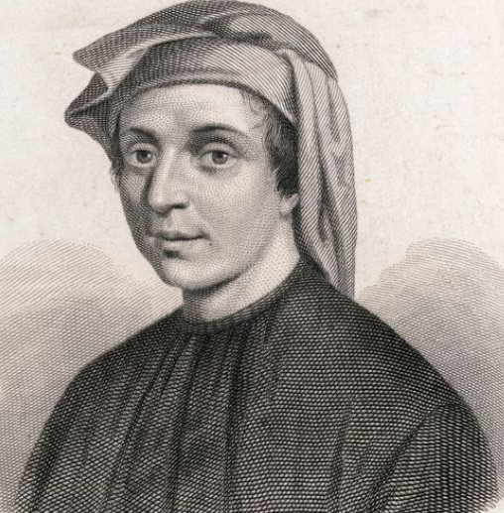
Fibonacci numbers
The Fibonacci numbers are the sequence of numbers defined by
the linear recurrence equation
F_{n} = F_{n-1} + F_{n-2}
with F₀ = 0 and F₁ = 1
Fibonacci sequence is 0, 1, 1, 2, 3, 5, 8, 13, 21, 34, 55, 89, 144, …
For example, F₂₀ = 6765
Leonardo of Pisa
1170 – 1240-50

Slide 11
Computer program to calculate
Fibonacci numbers
def Fibonacci(n):
'''recursive Fibonacci number computation
in Python'''
if n == 0: return 0
if n == 1: return 1
return Fibonacci(n-1) + Fibonacci(n-2)
print (Fibonacci(6)) # 8
print (Fibonacci(20)) # 6765
F_{n} = F_{n-1} + F_{n-2}
with F₀ = 0 and F₁ = 1
We can run Python programs online at:
https://repl.it/languages/python
We can prepare test cases for our program using Internet site
https://www.wolframalpha.com
From Wolfram site we get fibonacci 20= 6765

Slide 12
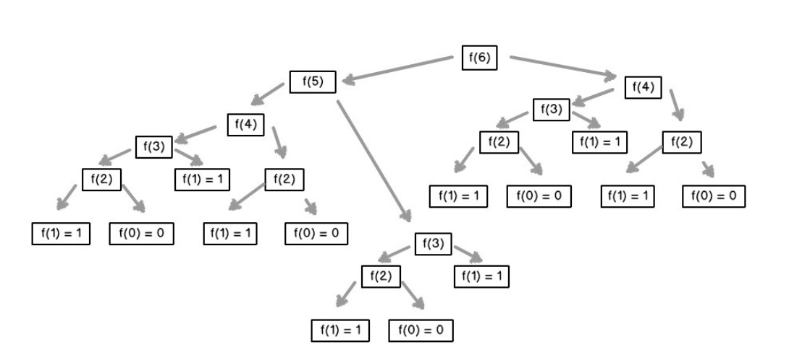
How actually recursion works

Slide 13
The power of recursion
Mastering the recursion technique allows us to develop a solution
to problems which are
not recursive at the first sight!

Slide 14
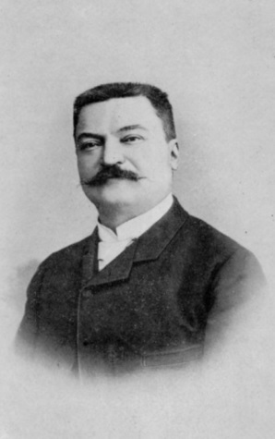
Complicated mathematical game
In a temple in the city of Benares, India are 64 discs of precious diamants piled up to a tower. Each of these round discs is just a little smaller than the disc below. Some holy men, monks, have the god given task to move this tower to a new place inside the temple. By doing this they have to obey some holy rules.
The discs are just allowed to be placed at three marked places inside the temple. The first place is the one where the tower was before they started to move it, the second place is the place of the destination, the third place is right between start and destination.
The discs are so heavy and precious that the holy rules allow just a movement of one disc at a time.
The last rule says that it is at no time allowed to place a disc on top of a smaller disc, while it is always allowed to place a disc on any disc with a greater diameter.
At the time when the monks have finished their work and the whole tower is moved from its starting place to its destination, at that very time, the tower will collapse and turn to dust and with this tower the whole earth will cease to exist.
François Édouard Anatole Lucas
1842 - 1891

Slide 15
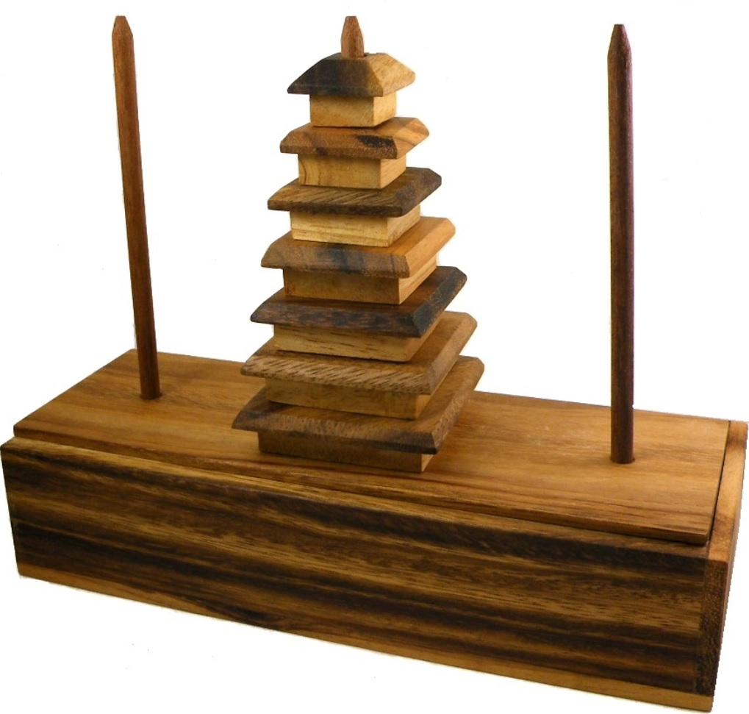
Formal description of the game
Towers of Hanoi
The game consists of three rods and a number of disks of different sizes, which can slide onto any rod.
The game starts with the disks in a neat stack in ascending order of size on one rod, the smallest at the top, thus making a conical shape.
The objective of the game is to move the entire stack to another rod, obeying the following simple rules:
1. Only one disk can be moved at a time.
2. Each move consists of taking the upper disk from one of the stacks and placing it on top of another stack or on an empty rod.
3. No larger disk may be placed on top of a smaller disk.

Slide 16
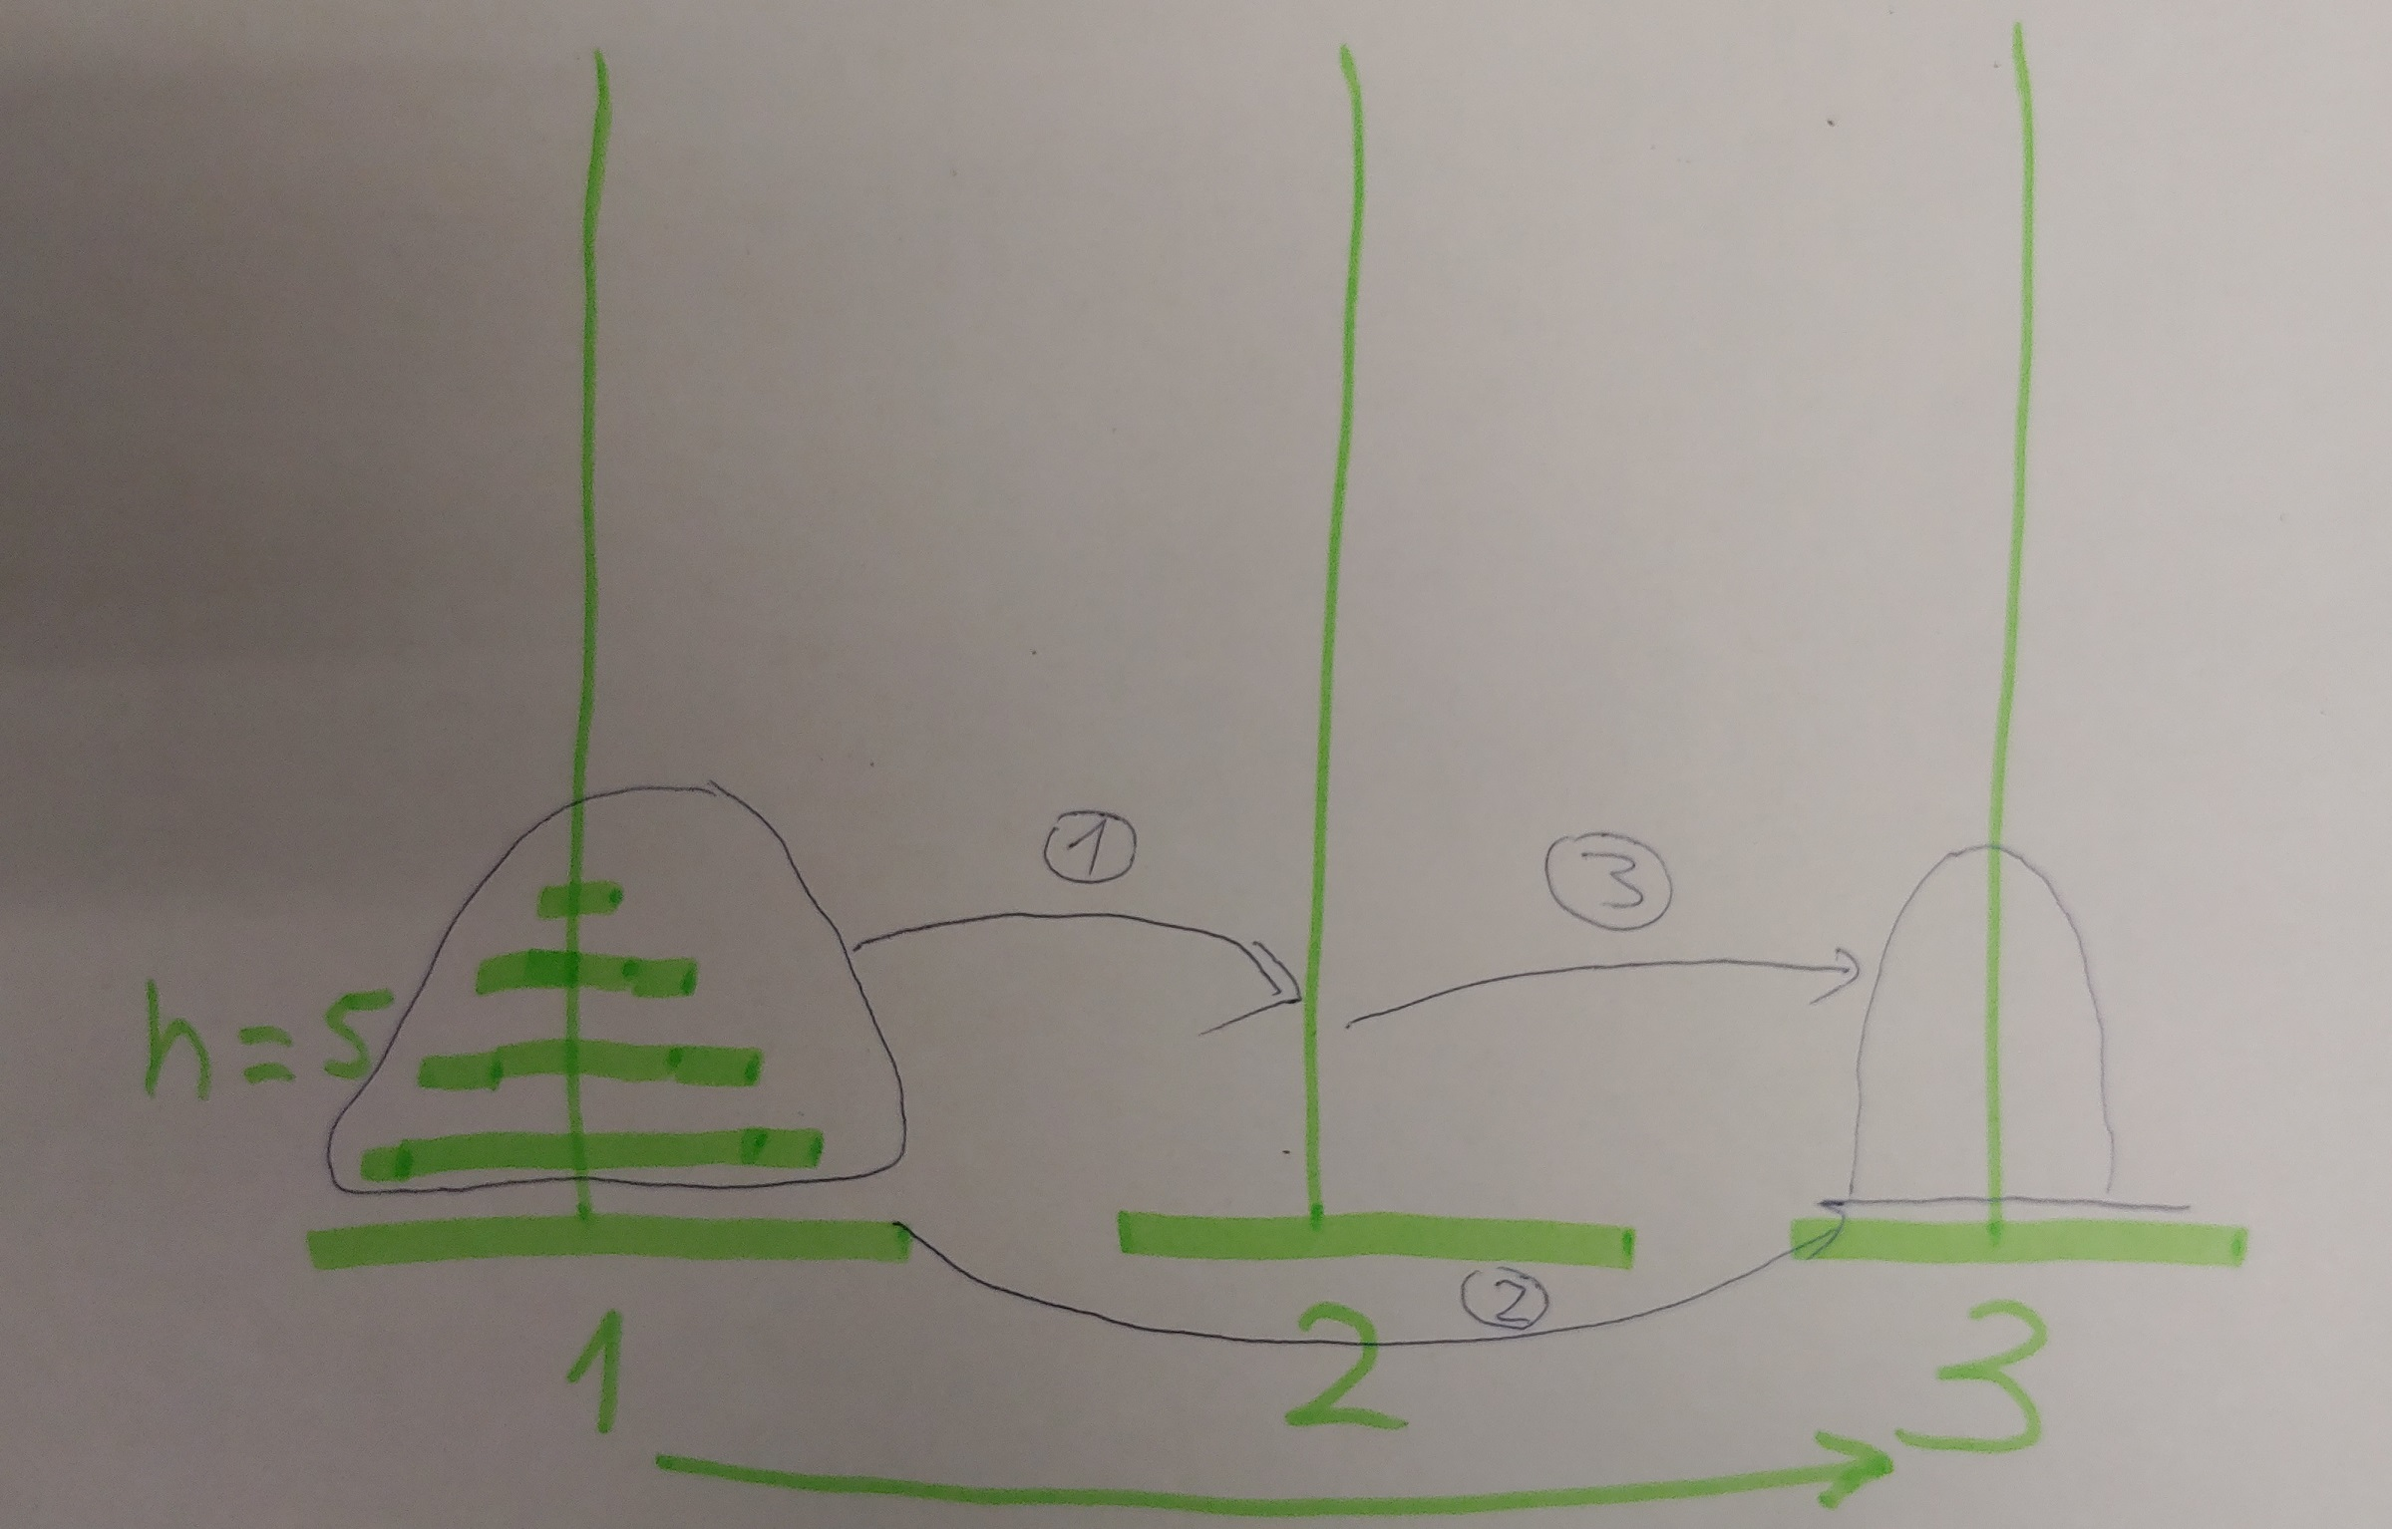
Reduction of the game solution process to a recursive process

Slide 17
Computer program to calculate moves for Towers of Hanoi
n = 3
1 -> 3
1 -> 2
3 -> 2
1 -> 3
2 -> 1
2 -> 3
1 -> 3
def Hanoi(n, beg, end):
'''recursive Towers of Hanoi computation in Python'''
if n == 1:
print(beg,'->', end)
return
Hanoi (n - 1, beg, 6 - beg - end) #sum of all towers is 6
print(beg,'->', end)
Hanoi (n - 1, 6 - beg - end, end)
return
Hanoi(3, 1, 3) # 7 moves are needed
We can run Python programs online at:
https://repl.it/languages/python

Slide 18
How long it takes to finish the game?
At the time when the monks have finished their work
the whole earth will cease to exist.

Slide 19
Time to finish the game is to be found by solving a recursive relation
if n == 1:
print(beg,'->', end)
return
Hanoi (n - 1, beg, 6 - beg - end)
print(beg,'->', end)
Hanoi (n - 1, 6 - beg - end, end)
return
T(1) = 1
T(n) = T(n-1) + 1 + T(n-1)

Slide 20
Solution of the recursive relation
Observations:
T(1) = 1
T(2) = 3
T(3) = 7
T(4) = 15
T(5) = 31
T(6)= 63
. . .
T(1) = 1
T(n) = T(n-1) + 1 + T(n-1)
Hypothesis:
T(n) = 2^{n} - 1

Slide 21
Proof of hypothesis
Proof can be accomplished by a technique called mathematical induction.
We have to prove that T(n) = 2^{n}-1, for every natural number n = 0, 1, 2, …
The method of induction requires two cases to be proved.
The first case, called the base case (or, sometimes, the basis), proves that the property holds for the number 0.
The second case, called the induction step, proves that if the property holds for one natural number n , then it holds for the next natural number n+1 .
For our game, first case, T(0) = 2⁰ – 1 = 1 – 1 = 0, property holds
For our game, second case,
T(n) = 2*T(n-1) + 1 = 2*(2^{n-1} – 1) + 1 = 2^{n} – 2 +1 = 2^{n} - 1, property holds
Conclusion: T(n) = 2^{n}-1

Slide 22
How long it takes to finish the game with 64 discs
Now we are able to calculate the time needed to move 64 discs
according to the rules of the game.
T(64) = 2⁶⁴ – 1 = 18446744073709551615 units of time
We can calculate 2⁶⁴ – 1 using Internet site
https://www.wolframalpha.com
18446744073709551615/3600/24/365 =
584 942 417 355 years ≈ 585 billion years to finish

Slide 23
Recursion as a basis for divide-and-conquer algorithm
In computer science, divide and conquer is an algorithm design paradigm
based on multi-branched recursion.
A divide-and-conquer algorithm works by recursively breaking down a problem
into two or more sub-problems of the same or related type,
until these become simple enough to be solved directly.
The solutions to the sub-problems are then combined
to give a solution to the original problem.
This divide-and-conquer technique is the basis of efficient algorithms
for all kinds of problems,
such as sorting (e.g., quicksort, merge sort),multiplying large numbers,
finding the closest pair of points, syntactic analysis (e.g., top-down parsers),
and computing the discrete Fourier transform.

Slide 24
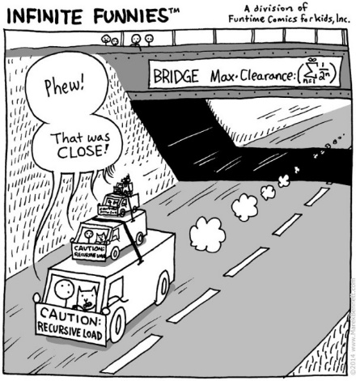

Slide 25
Thanks!
uldis.straujums at lu.lv

